Slide 1
Butanol Blends as Marine Fuels
An Overview
Thomas Wallner
Argonne National Laboratory
Seminar at IBEX
The International BoatBuilders’ Exhibition & Conference
Louisville, KY October 3, 2012

Slide 2
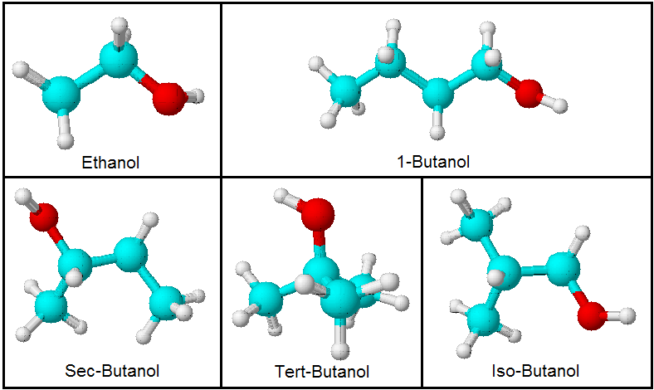
What is Butanol?
A four carbon alcohol (C4H9OH), colorless, neutral liquid of medium volatility with a characteristic banana-like odor.
Traditionally petrochemically derived - generally used to make other chemicals, or used as a solvent or an ingredient in formulated products such as cosmetics.
Butanol exists in four (4) different isomers:
The structure of the four (4) isomers of butanol in comparison to ethanol (a two carbon alcohol (C2H5OH))

Slide 3
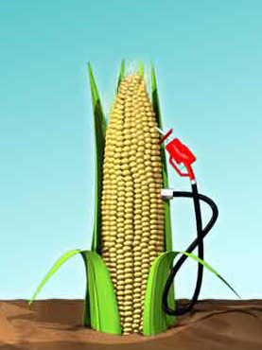
How is Butanol made?
Acetone-butanol-ethanol (ABE) fermentation is a commonly used process
Can be biologically derived from
biomass in a fermentation process
using microorganisms – Biobutanol
Biobutanol fermentation differs from
bioethanol mainly in the use of bacteria
An existing ethanol plant can be
converted to make butanol
Yield per acre (or bushel) of butanol is
lower on a volumetric scale but
equivalent on an energy scale

Slide 4
Properties of Butanol - Overview
 | Gasoline (EEE) | Ethanol | 1-butanol | 2-butanol | 3-butanol | Iso-butanol
Composition (C,H,O) (% mass) | 86, 14, 0 | 52, 13, 35 | 65, 13.5, 21.5 | 65, 13.5, 21.5 | 65, 13.5, 21.5 | 65, 13.5, 21.5
RON | 97 | 107.4 | 98.3 | 106 | 105 | 105.1
MON | 88.3 | 88.2 | 84.4 | 92 | 89 | 89.3
Melting point (ºC) | - | -112 | -79.9 | -114.7 | 25.5 | -108
Energy content (MJ/kg) | 42.9 | 25.6 | 32.9 | 32.9 | 32.9 | 32.8
Density (kg/L) | 0.742 | 0.789 | 0.81 | 0.81 | 0.79 | 0.81
Energy content relative to gasoline (%) | - | 64 | 84 | 84 | 82 | 83
Solubility in water | <0.1 | Fully miscible | 7.7 |  |  | 7.6
High knock resistance = Performance
High energy content = Range
Low solubility = Simplified storage/transport

Slide 5
Properties of Butanol – Phase Seperation
As water enters a boat fuel system containing ethanol-extended fuels, phase separation may occur creating an ethanol/water fuel mixture.
Butanol does not phase-separate (cylinder on the right)
Effect of adding 10% water by volume to 85% ethanol and 10% water by volume to 85% butanol

Slide 6
Properties of Butanol – Energy Content of Blends
16 Vol-% Butanol in Gasoline is equivalent in energy content to
10 Vol-% Ethanol in Gasoline

Slide 7
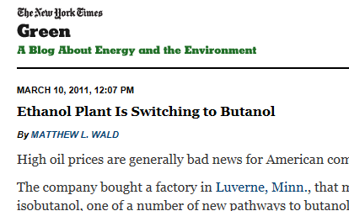
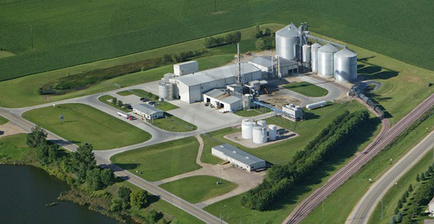
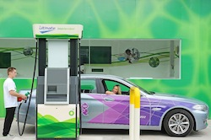
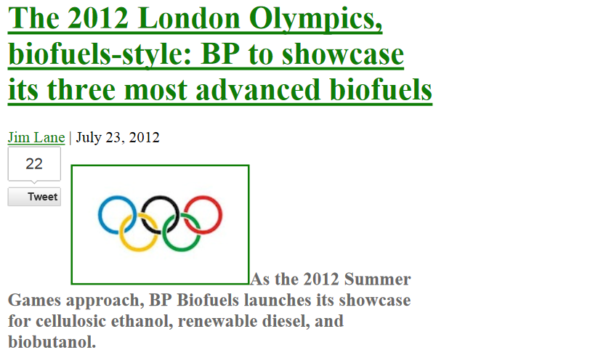
Butanol today

Slide 8
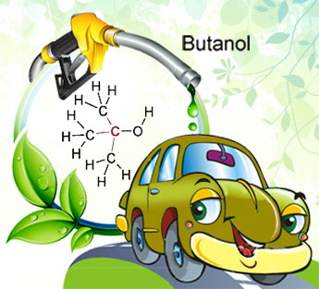
Properties of Butanol - Summary
Less susceptible to phase separation means butanol could be successfully delivered in existing pipelines
Eliminates need for splash-blending
Least corrosive of alcohols
Higher energy content – can be
blended into gasoline at higher
percentages than ethanol (Butanol
at 16 Vol-% is equivalent in
gravimetric energy content to
ethanol at 10 Vol-%)
Butanol is produced and used today

Slide 9
Project Overview
  Sponsor: Department of Energy – Vehicle Technologies Program – Fuel Technologies
  Project partners
    Bombardier Recreational Products (BRP)
    Michigan Technological University (MTU)
    Argonne National Laboratory
  Project start: March 1, 2012
  Project duration: 12 months (Phase 1)

Slide 10
Butanol Blends as a Marine Fuel
An Overview
Thomas Wallner
Argonne National Laboratory
Seminar at IBEX
The International BoatBuilders’ Exhibition & Conference
Louisville, KY October 3, 2012

